Slide 1
Laser Cooling by Sawtooth Wave Adiabatic Passage
Huan Bui
ZGS – August 26th, 2022

Slide 2
Laser Cooling

Slide 3
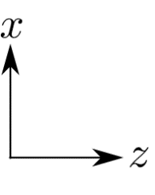
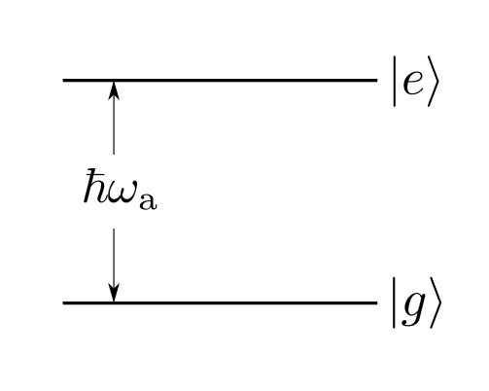
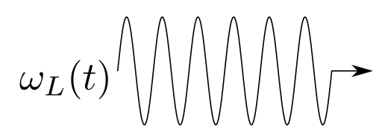
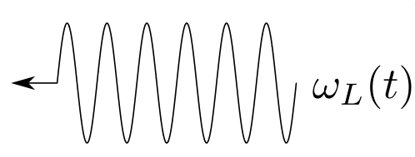
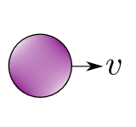
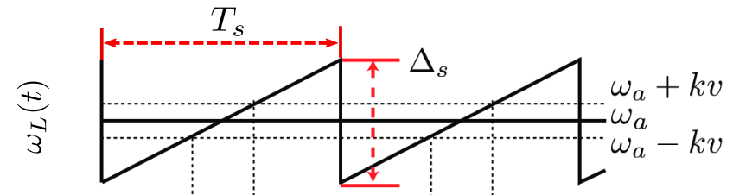
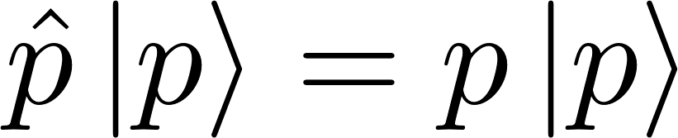
Basic mechanism

Slide 4
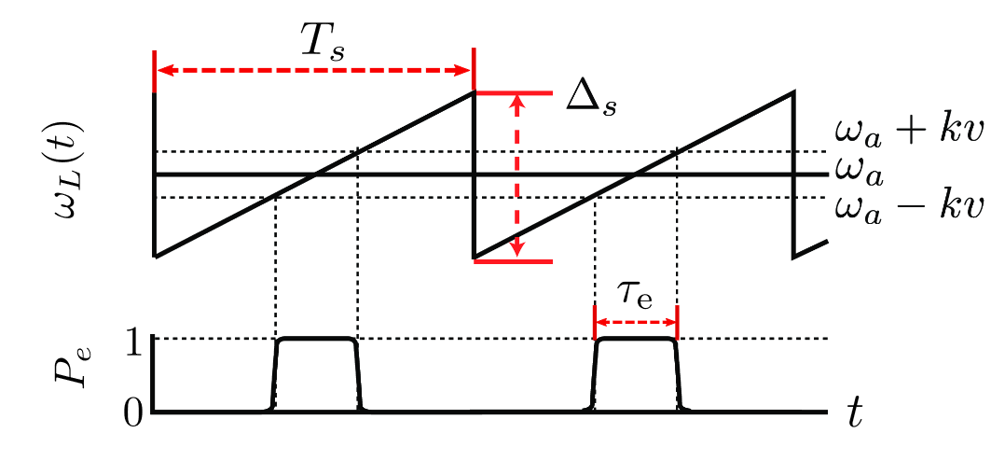
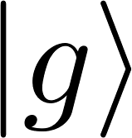
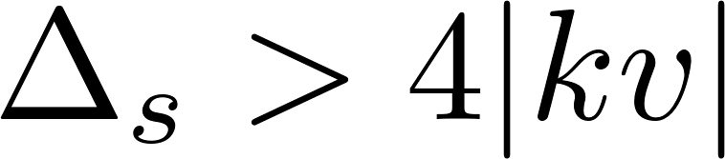
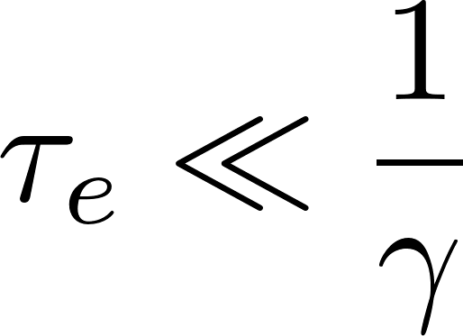

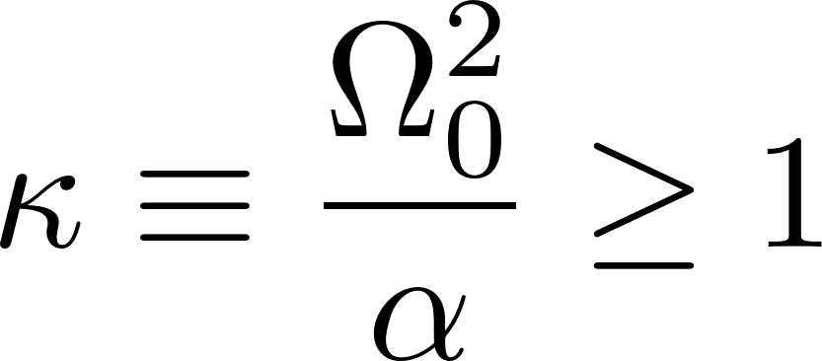

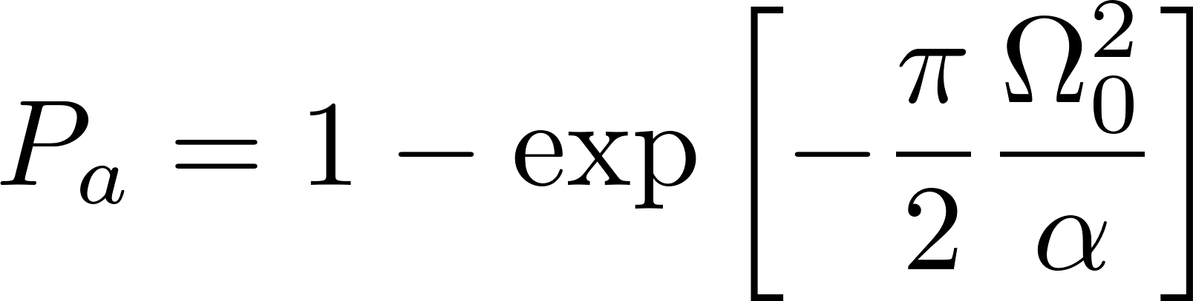
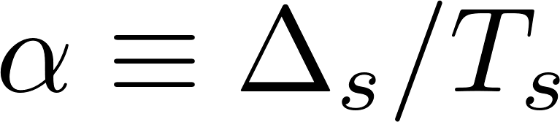
Requirements
Must begin sweep in :
Low decay probability during :
Large adiabatic transition probability:
: adiabaticity parameter

Slide 5

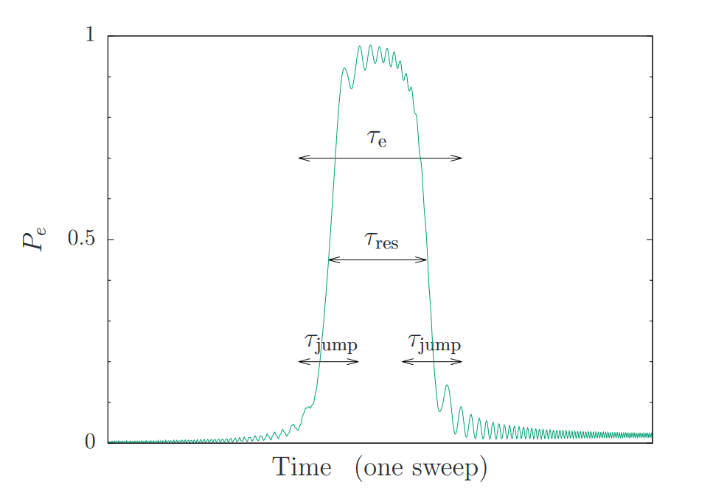
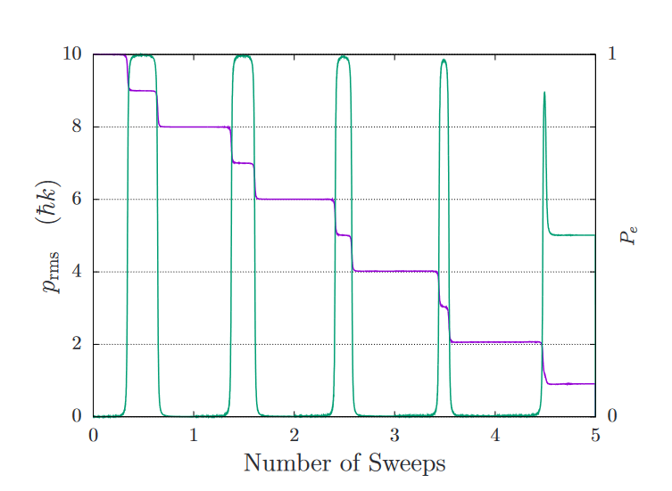
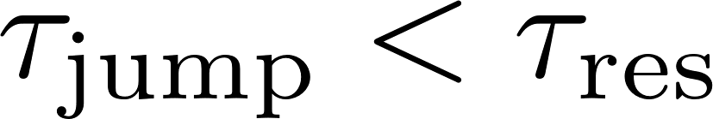
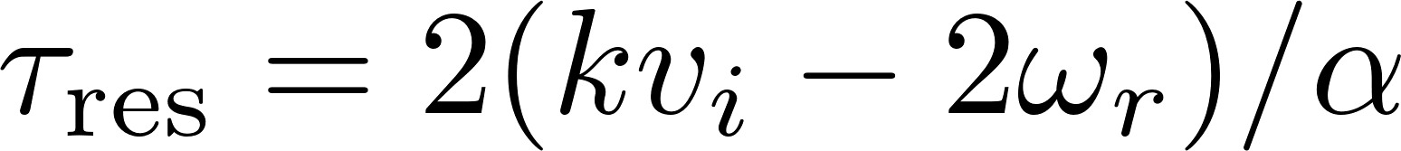
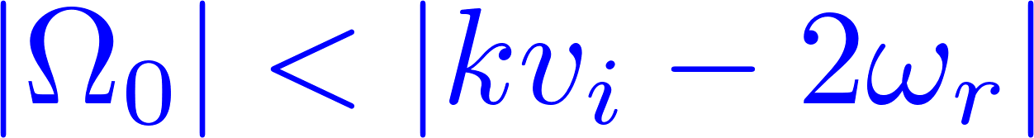
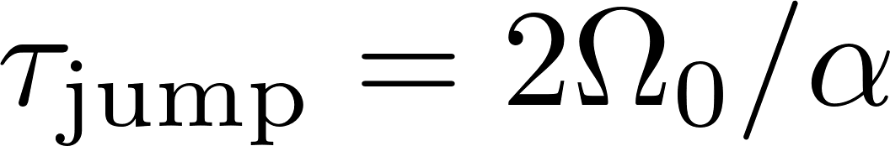
Validity
Particle interacts sequentially with one wave and then the other
→ Need sufficiently large
When adiabatic:
Want

Slide 6
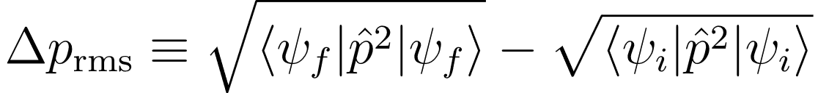
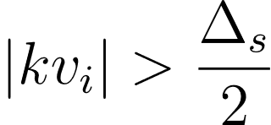
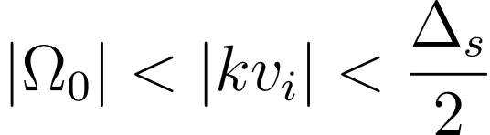

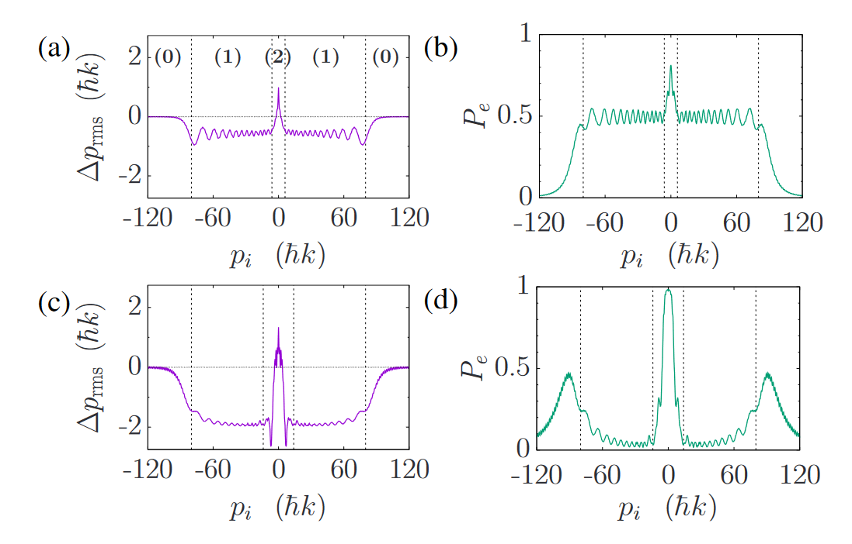
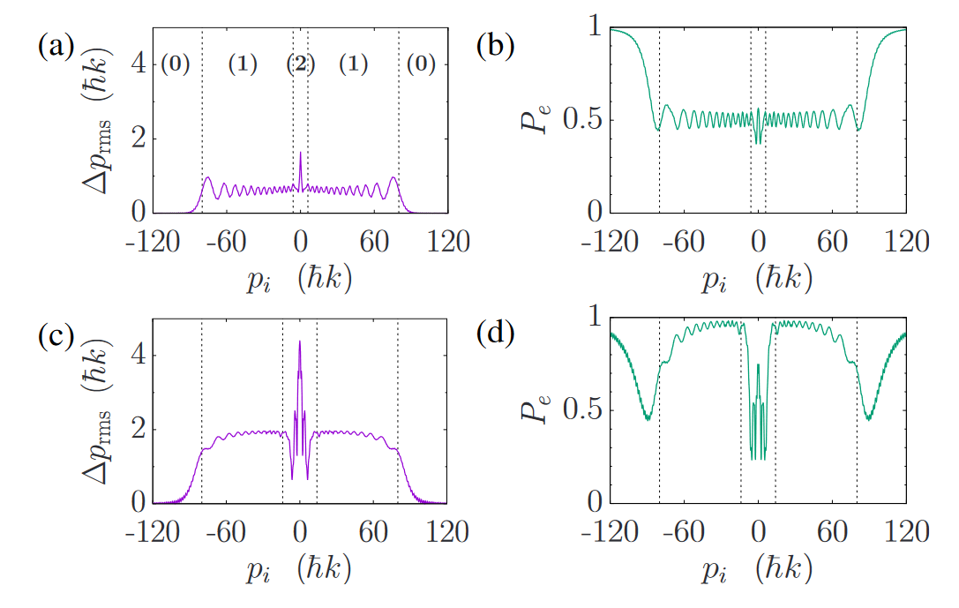
Forces and capture range
Conservative forces:
3 velocity regimes:
(0)
(1)
(2)
no interaction
high-v regime
more complicated…
diabatic
adiabatic

Slide 7
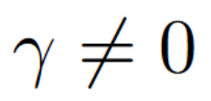
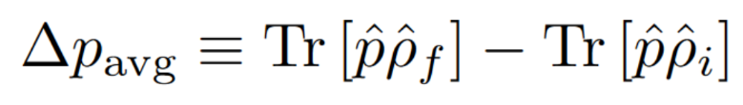


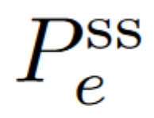
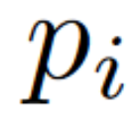
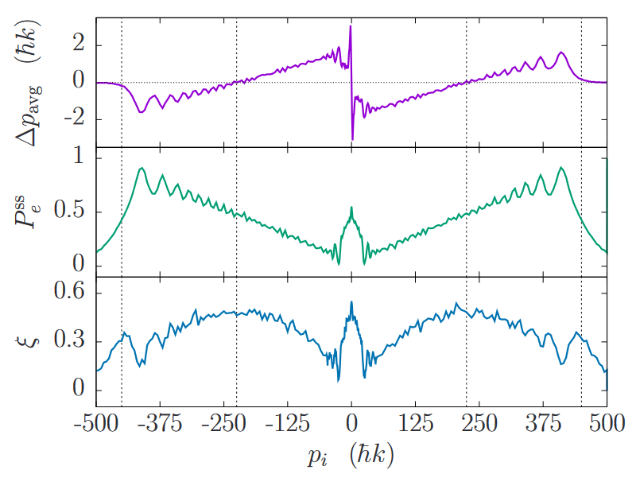

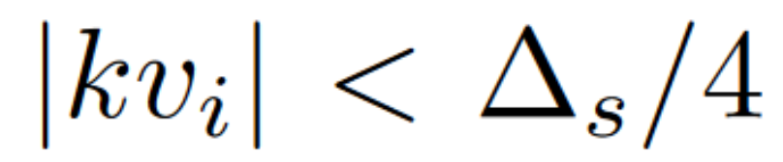
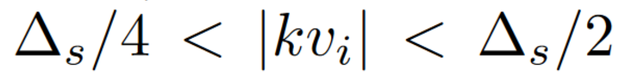
Forces and capture range
Forces with dissipation, ::
One sweep dynamics:
: steady-state population for each
: avg number of incoherent scattering events
Impulse towards zero for
→ Capture range
Impulse away from zero for

Slide 8



Forces and capture range
Forces with dissipation, ::
One sweep dynamics:
: steady-state population for each
: avg number of incoherent scattering events
Impulse of imparted for
Low scattering rate
Average force:
4 x radiation pressure force at saturation
→ SWAP cools with relatively low scattering rate
complicated dynamics at low momentum:
Bragg oscillations, Dopplerons, ambiguous time-ordering

Slide 9

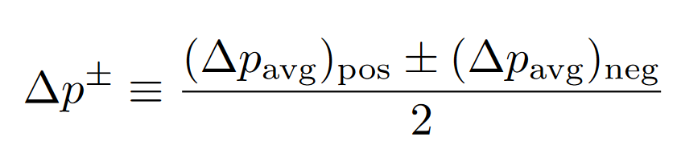
Forces and capture range
Forces with dissipation, ::
One sweep dynamics:
Bragg oscillations mix atom between
independent of sweep direction
Look at:
→ Effects present in (+), cancel in (-)
complicated dynamics at low momentum:
Bragg oscillations, ambiguous time-ordering,…

Slide 10
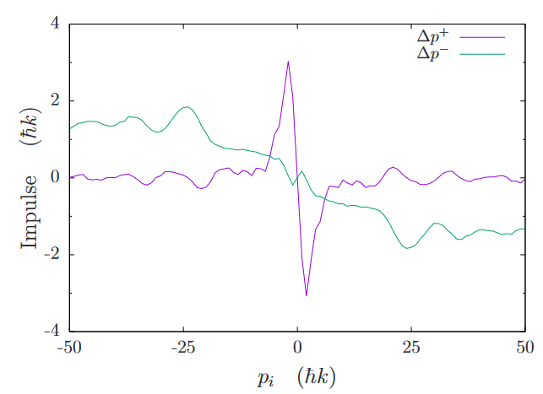
Forces and capture range
Forces with dissipation, ::
One sweep dynamics:
Bragg oscillations mix atom between
independent of sweep direction, by symmetry
Look at:
→ Effect present in (+), cancels in (-)

Slide 11
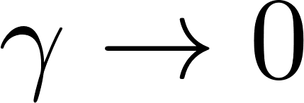
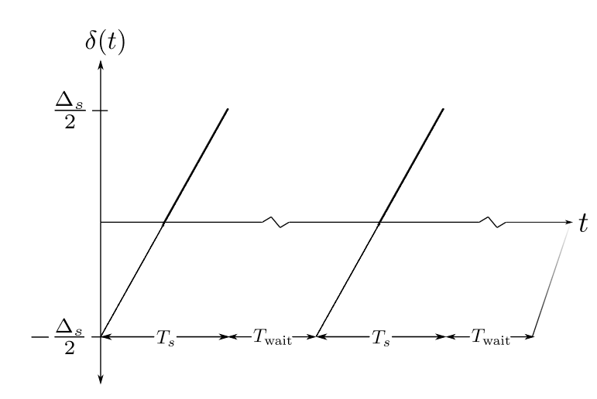
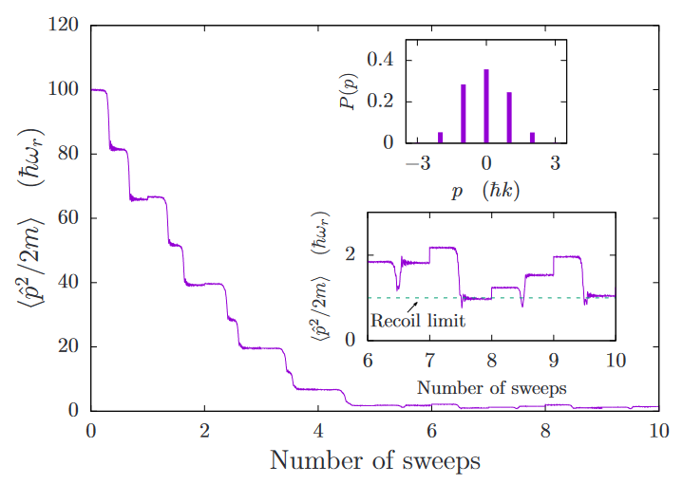




Temperature limit as
Sweep-wait scheme: mimics cooling process for particle with ultranarrow linewidth

Slide 12

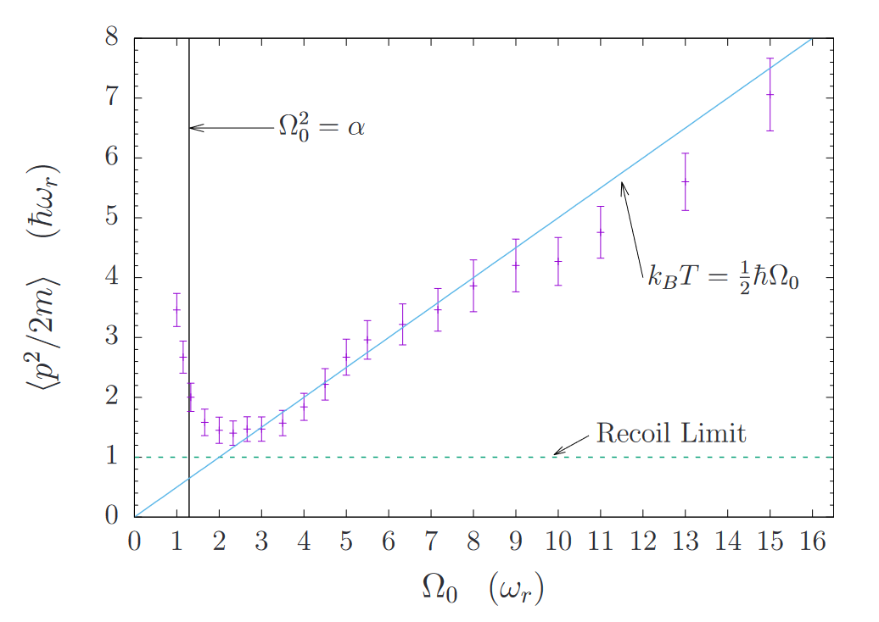
Temperature limit as
Scaling with :
Reduced conservative force
+ high excited state fraction → more diffusion due to spon. emission
Decreased time ordering between
Adiabatic transfers → particles spend more time in the excited state

Slide 13
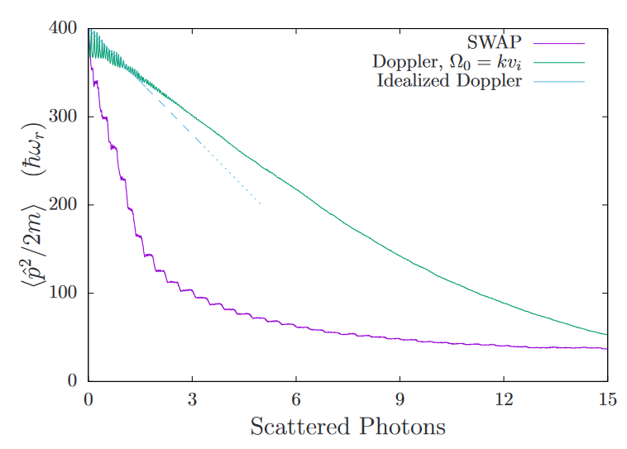
Cooling efficiency
Cooling efficiency ≡ energy removed per scattering
Many fewer scatterings required than Doppler
SWAP is well-suited to cooling e.g. particles that
lack closed cycling transitions

Slide 14
Applications

Slide 15
Extra material

Slide 16
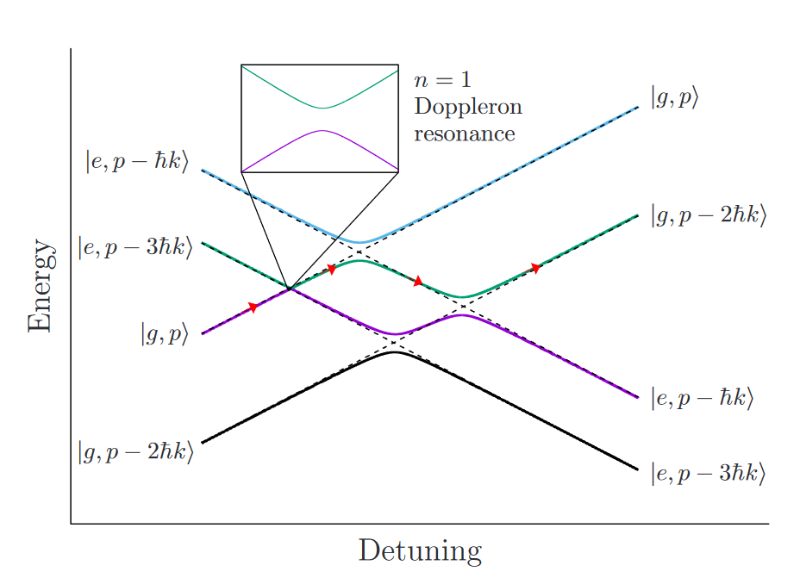
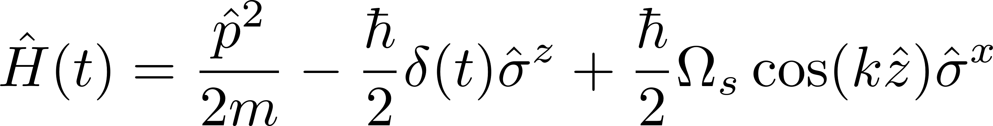
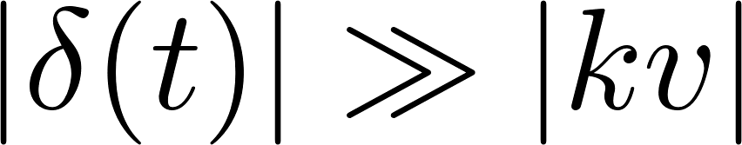
Dynamics
Large detuning limit:

Slide 17
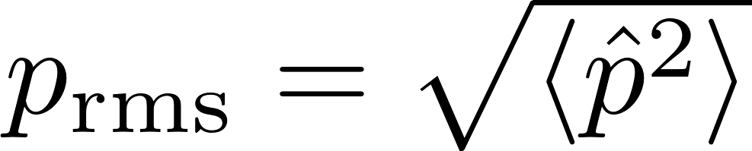
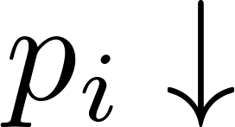
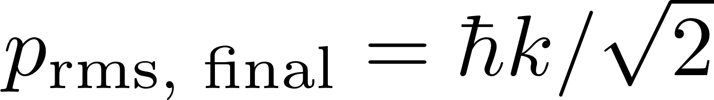
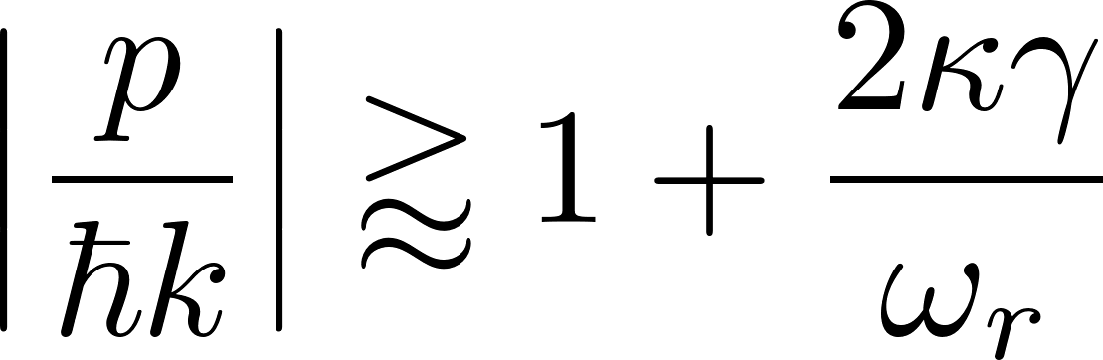
Dynamics
Coherent evolution:
→ Doppler shift decreases → pulse narrows
Effective force drives particle to zero velocity
→ unlike “slowing force” in e.g. chirped-frequency light
With spontaneous emission:

